Slide 1
An Introduction to R
Day 1 – 18/09/2017

Slide 2
Agenda – Day 1
An Overview of R
History of R
Why R?
Features & Drawbacks of R
Installing R
Different windows in R
Installing RStudio
Different windows in RStudio
2017 SAS, R, or Python Flash Survey Results

Slide 3
An Overview of R

Slide 4


History of R
What is R?
R is a dialect of the S language
Back to R :
1991 : Created in New Zealand by Ross Thaka and Robert Gentleman. Their experience in developing R is documented in JCGS paper (year -1996)
1993 : First announcement of R to public
1995 : Martin Mächler convinced Ross and Robert to use the GNU General Public License to make R free software
2000 : R version 1.0.0 was released
2013 : R version 3.0.2 was released on October 2013 (bug fix release Dec 2013)
2017 : R version 3.4.1 was released on April 2017 (bug fix release June 2017)
Ross
Robert
Note :
R releases new version twice in a year, once in April and again in October.
This is important to know because frequently we have to update our R version

Slide 5









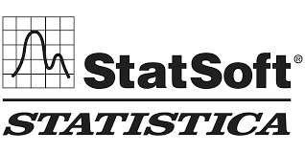
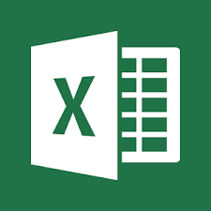



Why R?
Why we have to learn R, when we have tools like SAS, SPSS, Rapid miner?
Because...
It is an open source software
It runs on a variety of platforms including Windows, Unix and Mac OS (Operating System)
Frequent releases (annual +bug fix release): active development
Widely used statistical tools:

Slide 6
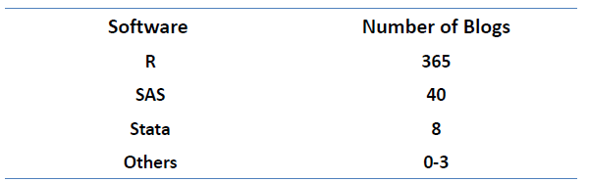
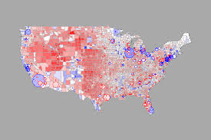
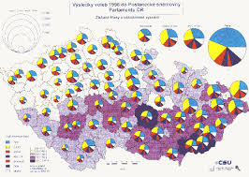

Features & Drawbacks of R
Features :
It contains advanced statistical routines which are not available in other tools (basic version)
Graphical capabilities are better than other tools (basic version)
There are many online forums, email lists, interest groups, blogs, and websites full of rich information about R
Drawbacks :
Essentially based on 40 years old technology
R makes use of system memory to handle data processing and this would limit the amount of data that can be handled based on system's RAM capabilities.
Higher system RAM provides better processing (e.g.) systems with 16 GB RAM performs better than 8 GB for processing large datasets.
One of the common memory error shown in R console would be – cannot allocate vector of size

Slide 7
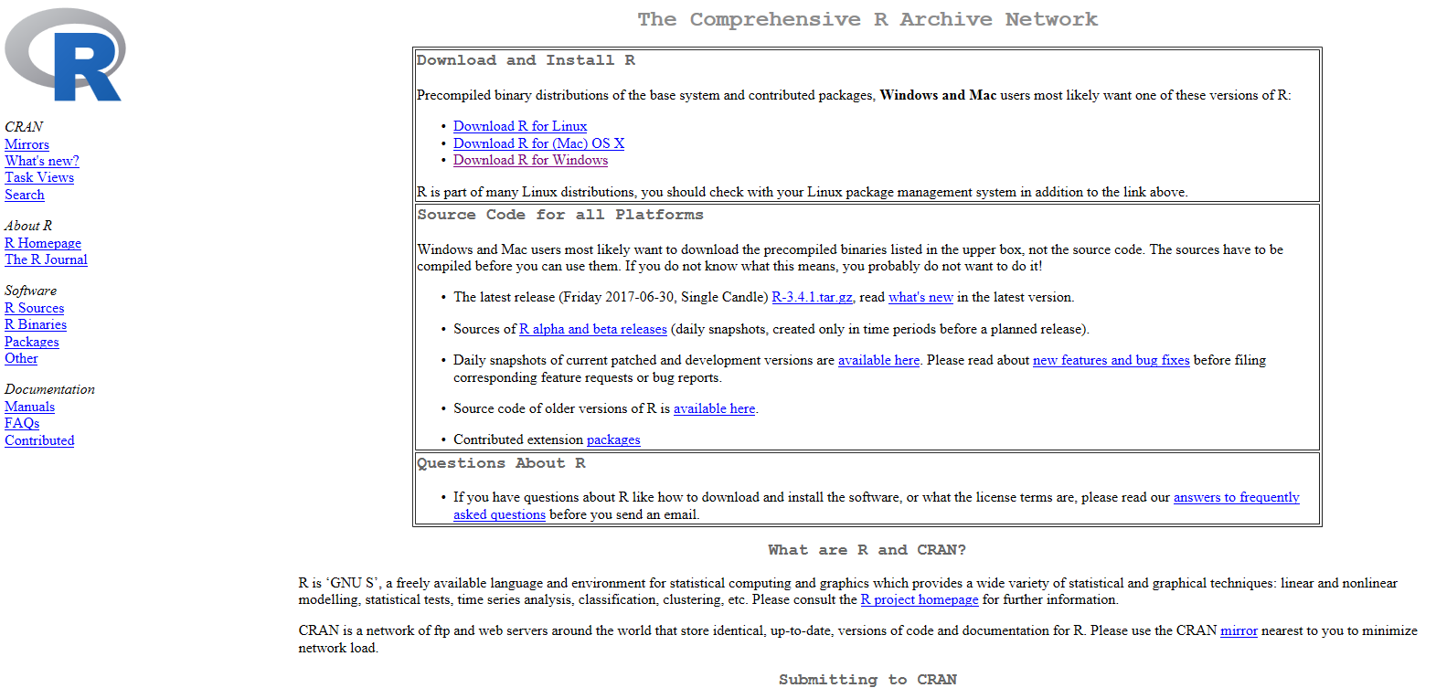
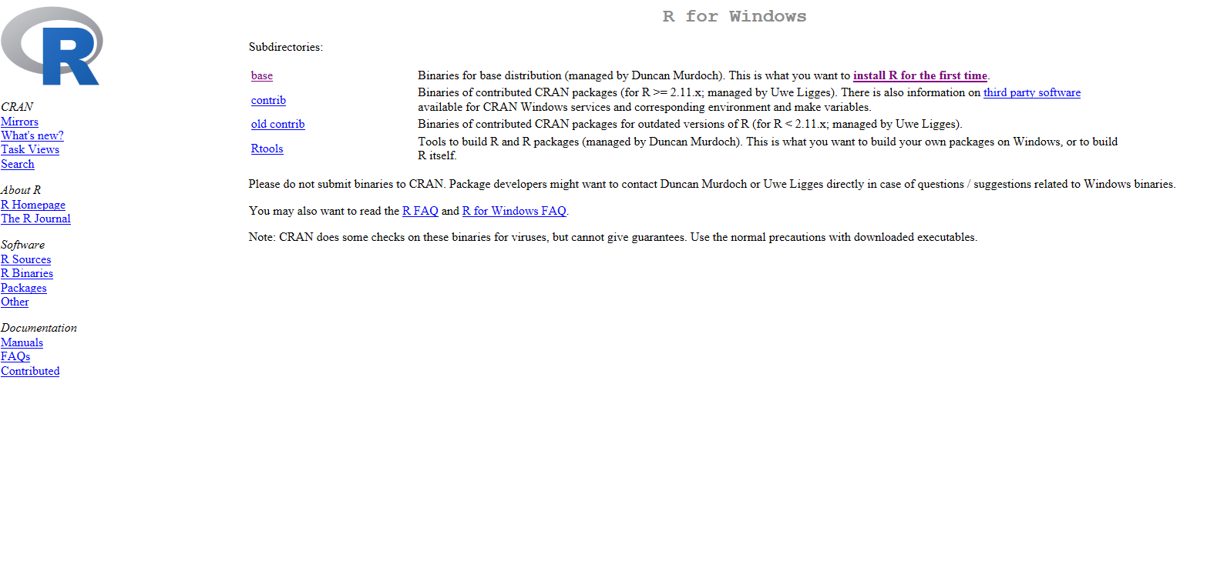
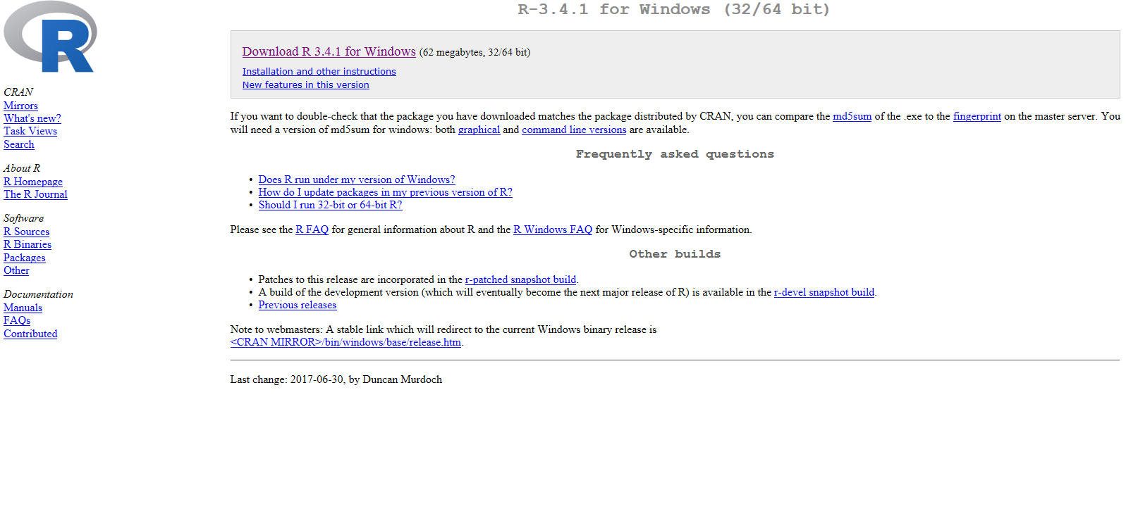
Installing R
Step 1 : Enter the path https://cran.r-project.org in web browser URL. You will be directed to a particular page (as shown in snap shot 1) and then select Download for Window if your system has Window OS else go for other options according to your System OS
Step 2 : Once you click on Download R for Windows, you will see a particular page (as in snap shot 2)
Step 3 : Once you click on install R for the first time, you will see a particular page (as in snap shot 3)
Step 4 : Once you click on Download R 3.4.1 for Windows (62 megabytes, 32/64 bit),R will get downloaded in your system
1
2
3

Slide 8
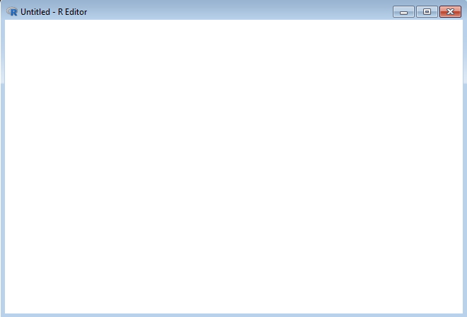
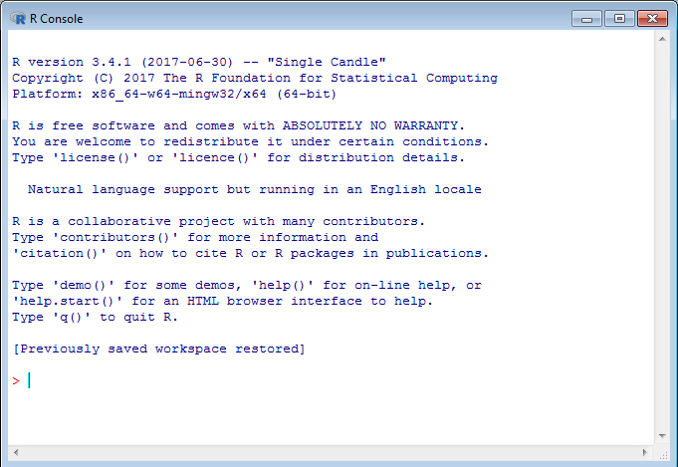
Different windows in R
Once you click on R icon in start menu, you get to see 2 different windows as shown in snap shots below
R Editor Window : Where multiple lines of code can be written. Users can save script file to disk and recall based on the requirement
R Console Window : All the interactive work of R is been performed here i.e. objects that you create the outputs will be displayed over here.
R Editor window
R Console window

Slide 9
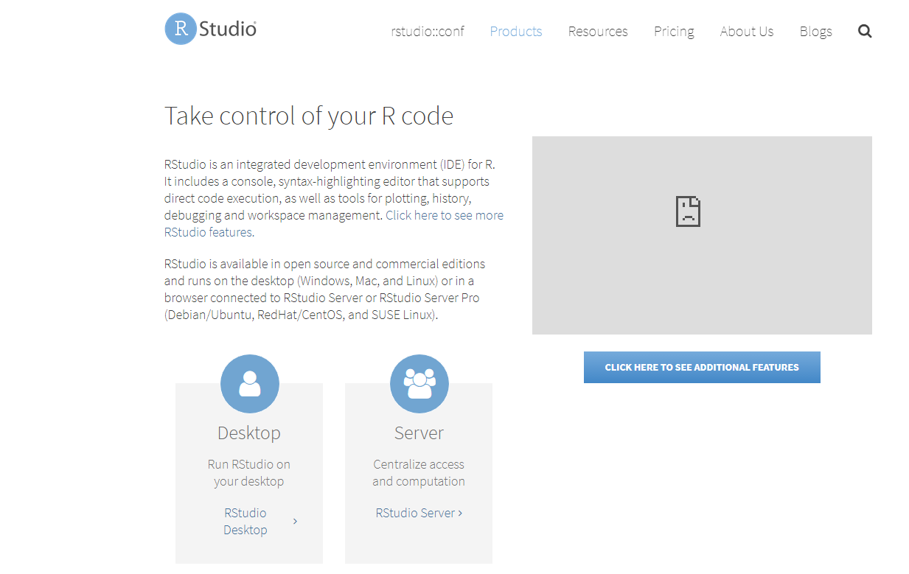
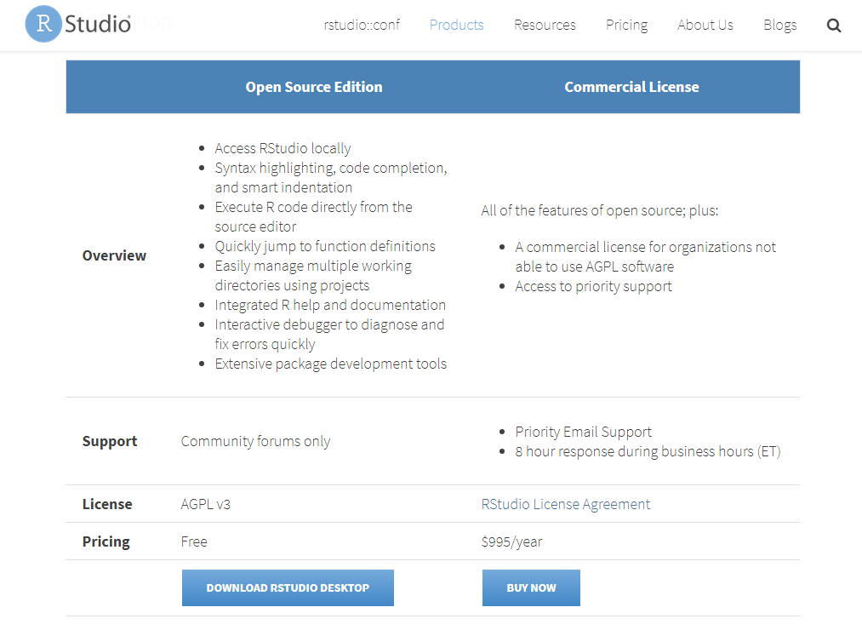
Installing R Studio
Step 1 : You can simply install your RStudio by doing a install RStudio on windows google search
Step 2 : As soon as you get your options, you will be able to see the RStudio – RStudio
Step 3 : Once you click on RStudio – RStudio you will be able to see a particular page (as in snap shot 1)
Step 4 : Once you click on Run RStudio on your desktop you will be able to see a particular page (as in snap shot 2)
Step 4 : Click on DOWLOAD RSTUDIO DESKTOP, Rstudio will get downloaded in your system
1
2

Slide 10
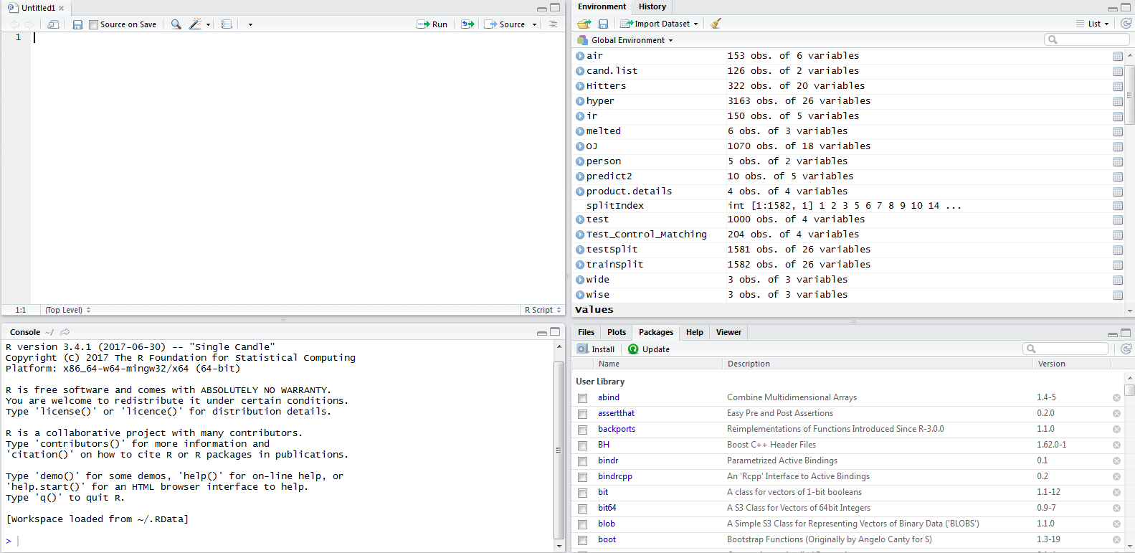
Different windows in RStudio (1/2)
RStudio: RStudio is a front end to R. You need R to make RStudio work.
RStudio makes using R a lot nicer by below features
It has automatic bracket matching
It has easy access to R help
It also has easy exploration of variables and values
Once you click on R icon in start menu, you get to see 4 different windows as shown in snap shots below
Source /Editor
Environment, History
Console
Files, Plots, Packages and Help

Slide 11
Different windows in RStudio (2/2)
Source / Editor : Where multiple lines of code can be written. Users can save script file to disk and recall based on the requirement
Console : All the interactive work of R is been performed here i.e. objects that you create the outputs will be displayed over here
Environment, History : Overview of workspace, where the variable created in the session along with their values can be inspected over here
This is also the area where the user can see a history of all the commands issued in R
Files: This is where the user can browse folders and files on a computer
Plots: This is where R displays all the user's plots that are been generated
Packages: This where the user can view a list of all the installed packages
Help: This is where you can browse the built-in Help system of R

Slide 12
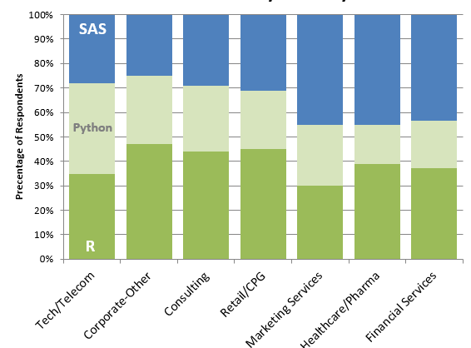
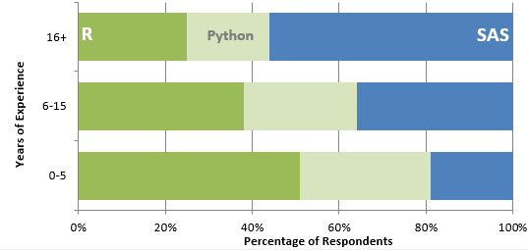












2017 SAS, R, or Python Flash Survey Results http://www.burtchworks.com/2017/06/19/2017-sas-r-python-flash-survey-results/
Tool preference by Industry & by years of experience:
Few Global companies that uses R for analysis:
Tool preference by Industry
Tool preference by years of experience

Slide 13
Appendix

Slide 14
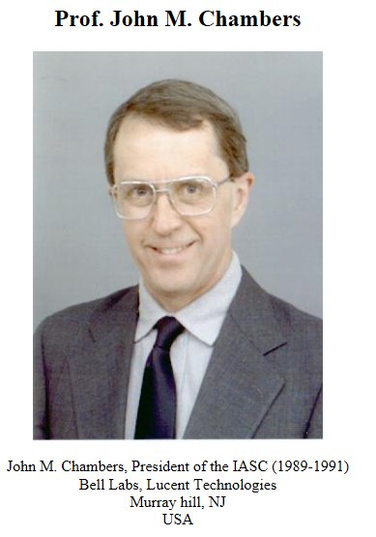



S Language and its History
Back to R
What is S?
S is a language that was developed by Prof. John M. Chambers and others at Bell Laboratories
S was initiated in 1976 as an internal statistical analysis environment
Historical notes:
In 1993 Bell Labs gave Insightful Corp. an exclusive License to develop and sell S language
Insightful sold its implementation of the S language under the product name S-PLUS
In 2008 Insightful was acquired by TIBCO for $25 million
The fundamental of the S language itself has not changed dramatically since 1998
Evolution of S language

Slide 15
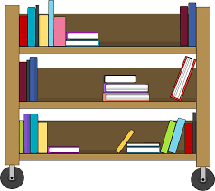
Package & Library
Flow of presentation
Package : Package is a self-contained set of code that adds functionality to R, similar in ways that add-in adds functionality to Microsoft Excel
Library : The directory where packages are stored is called the library
Package
Library

Slide 16


Declaring an Object
Flow of presentation
There are some restrictions when giving an object a name:
Object names cannot contain `strange' symbols like !, +, -,#
A dot (.) and an underscore ( _) are allowed, also a name starting with a dot
Object names can contain a number but cannot start with a number
Objects can be created using the assignment operators:
An arrow (<-) formed by a smaller than character and a hyphen without a space!
The equal character (=)

